Slide 1
UMKC Hackathon Fall 2016 Sentiment Engine By Dawn Busters
Manasa Thipparthi
Sri Harsha Kumar Raja Golla
Swarna Kosaraju
Sai Jyothi Gudibandi

Slide 2
Overview
Motto:- Our motto is to generate sentiments out of the real time tweets by various users on a particular topic.
Ex: Public’s Opinion on Trump etc.
Major Advantage:
We can get the actual feelings of an individual and it’s way more cost effective and efficient for many organizations to surge their profit graphs upward or to make an instant change rather than a long period survey.

Slide 3
Our Strategy
We have retrieved the Twitter streaming data using the Twitter API in a .json file.
Now this JSON data is given as a source to our application
There will be 2 kinds of search options
Search by Hotkey Bubbles
Search by Keyword
Now according to the user’s input our application will generate the sentiment analysis and shows the output in form of graph and further user can also see from which location the tweets are coming from.

Slide 4
Implementation
We have created an ionic application for this process.
We used the text col and coordinates col from the extracted tweet JSON and developed our application on their basis.
On the Home page user inputs the text using one of the 2 available methods
Our application searches for the word in our tweets .json file and make a sentiment analysis using Alchemy API and output one of Positive, Negative or Neutral Value to that user input
We further added a feature so that the user gets to know from which part of the world are these tweets coming from.

Slide 5
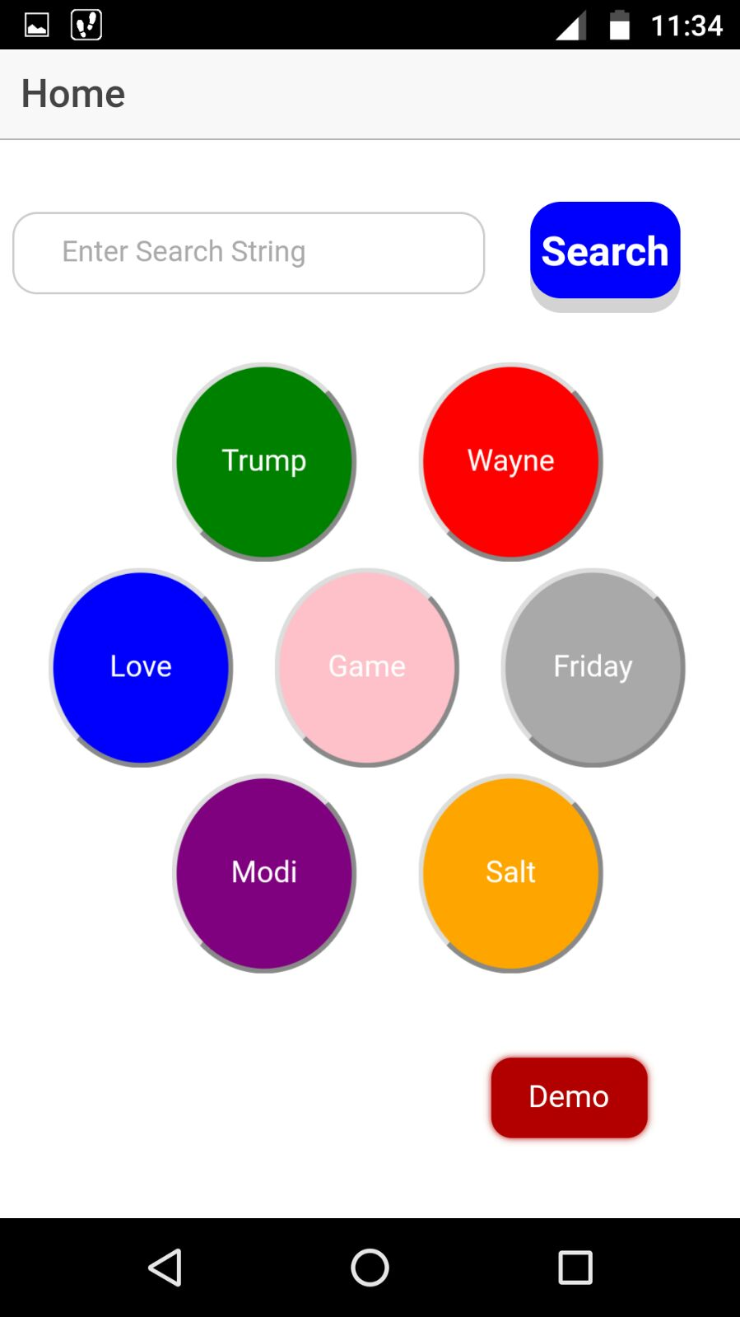
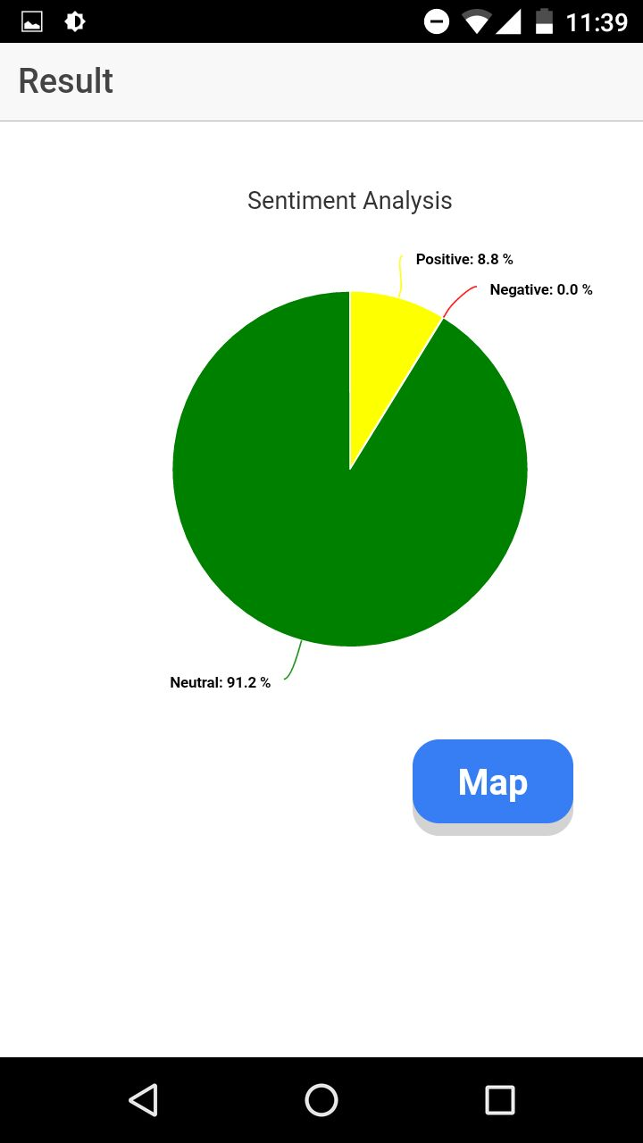
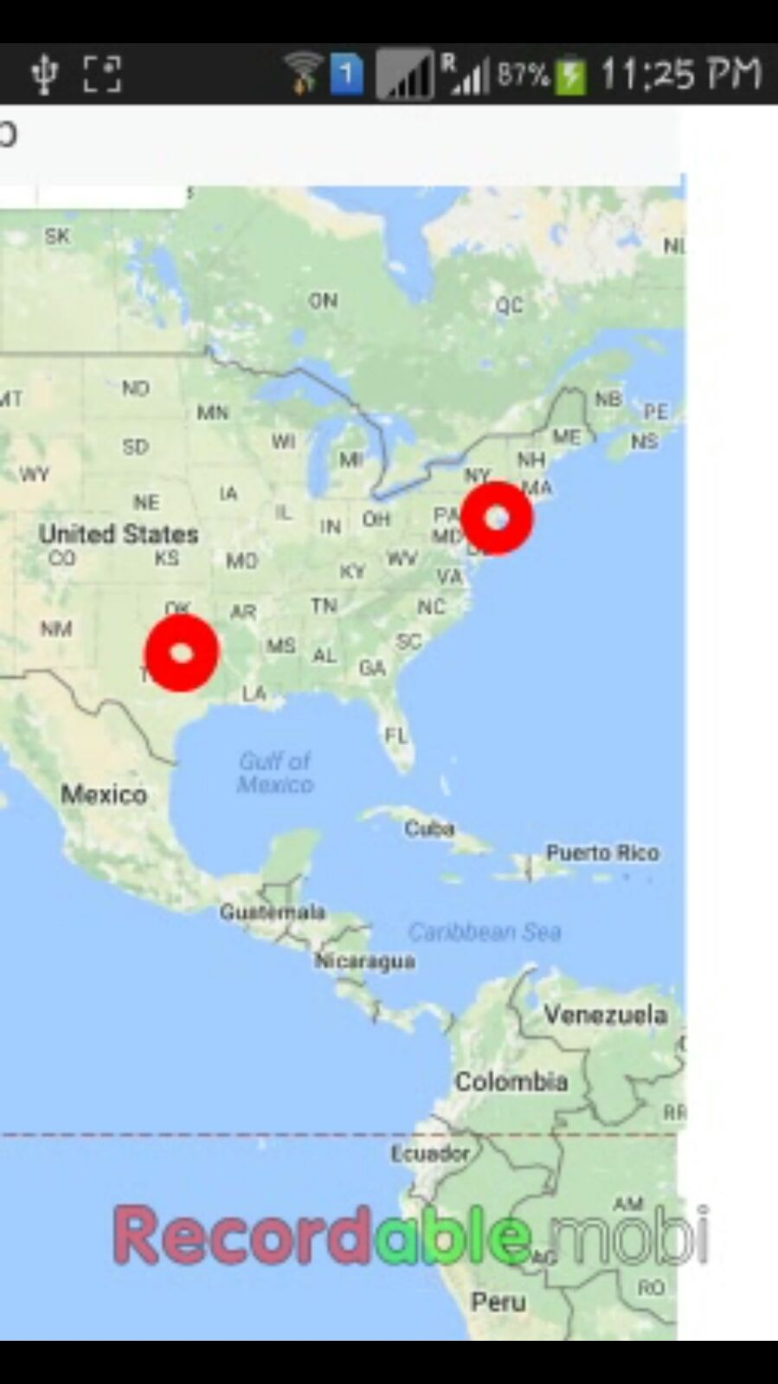
Our Application Screenshots

